Slide 1
Global Navigation with SPFx
Derek Cash-Peterson

Slide 2

MICROSOFT 365 VIRTUAL MARATHON Global Nav with SPFx
Derek Cash-Peterson
Principal Architect
@spdcp
Brought to you by:
The Global Microsoft Community &
#M365VM
M365VirtualMarathon.com
M365Conf.com | #M365CONF

Slide 3

Mark Your Calendars:
March 23-25, 2021, MGM Grand Resort
Las Vegas, Nevada, USA
M365Conf.com
#M365CONF
The SharePoint Conference is now The Microsoft 365 Collaboration Conference
Brought to you by:
The Global Microsoft Community &
#M365VM
M365VirtualMarathon.com
M365Conf.com | #M365CONF

Slide 4










THANK YOU TO ALL OUR GENEROUS SPONSORS

Slide 5

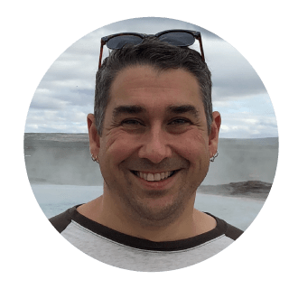


Derek Cash-Peterson Principal Architect Professional developer since 1999 Working with SharePoint since 2006 Specialize in branding/UX development https://spdcp.com linkedin.com/in/derek-cash-peterson-6320752 @spdcp https://github.com/dcashpeterson

Slide 6
Agenda
Why Build Your Own?
Anatomy of Global Navigation
PnP Dev Extensions Let’s Look at the Code!
Deployment
Q&A

Slide 7
Agenda
Why Build Your Own?
Anatomy of Global Navigation
PnP Dev Extensions Let’s Look at the Code!
Deployment
Q&A

Slide 8

Why Build Your Own?

Slide 9
Why Build Your Own?
Custom Code is not always the answer!

Slide 10
Why Build Your Own?
Custom Code is not always the answer!
Needs to be on every site regardless of hub association

Slide 11
Why Build Your Own?
Custom Code is not always the answer!
Needs to be on every site regardless of hub association
Need a custom user interface

Slide 12
Why Build Your Own?
Custom Code is not always the answer!
Needs to be on every site regardless of hub association
Need a custom user interface
Needs to work on classic and modern

Slide 13
Why Build Your Own?
Custom Code is not always the answer!
Needs to be on every site regardless of hub association
Need a custom user interface
Needs to work on classic and modern
Need custom functionality not currently part of the navigation
Audience targeting-Q2 2020
Need navigation on mobile

Slide 14
Why Build Your Own?
Custom Code is not always the answer!
Needs to be on every site regardless of hub association
Need a custom user interface
Needs to work on classic and modern
Need custom functionality not currently part of the navigation
Audience targeting-Q2 2020
Need navigation on mobile
Has anyone done this before?

Slide 15
Agenda
Why Build Your Own?
Anatomy of Global Navigation
PnP Dev Extensions Let’s Look at the Code!
Deployment
Q&A

Slide 16

Anatomy of Global Navigation
Placeholders (Top & Bottom)

Slide 17
Anatomy of Global Navigation
Placeholders (Top & Bottom)
Data Source

Slide 18
Anatomy of Global Navigation
Placeholders (Top & Bottom)
Data Source
Application Customizer

Slide 19
Anatomy of Global Navigation
Placeholders (Top & Bottom)
Data Source
Application Customizer
Classic Mode (JSLink)

Slide 20
Anatomy of Global Navigation
Placeholders (Top & Bottom)
Data Source
Application Customizer
Classic Mode (JSLink)
Common Code

Slide 21
Placeholders
A placeholder is a place in the DOM that has been designated by Microsoft for us to make changes to.
Top & Bottom
”Safe Zone” for customizations
Do not manipulate the DOM from here.

Slide 22
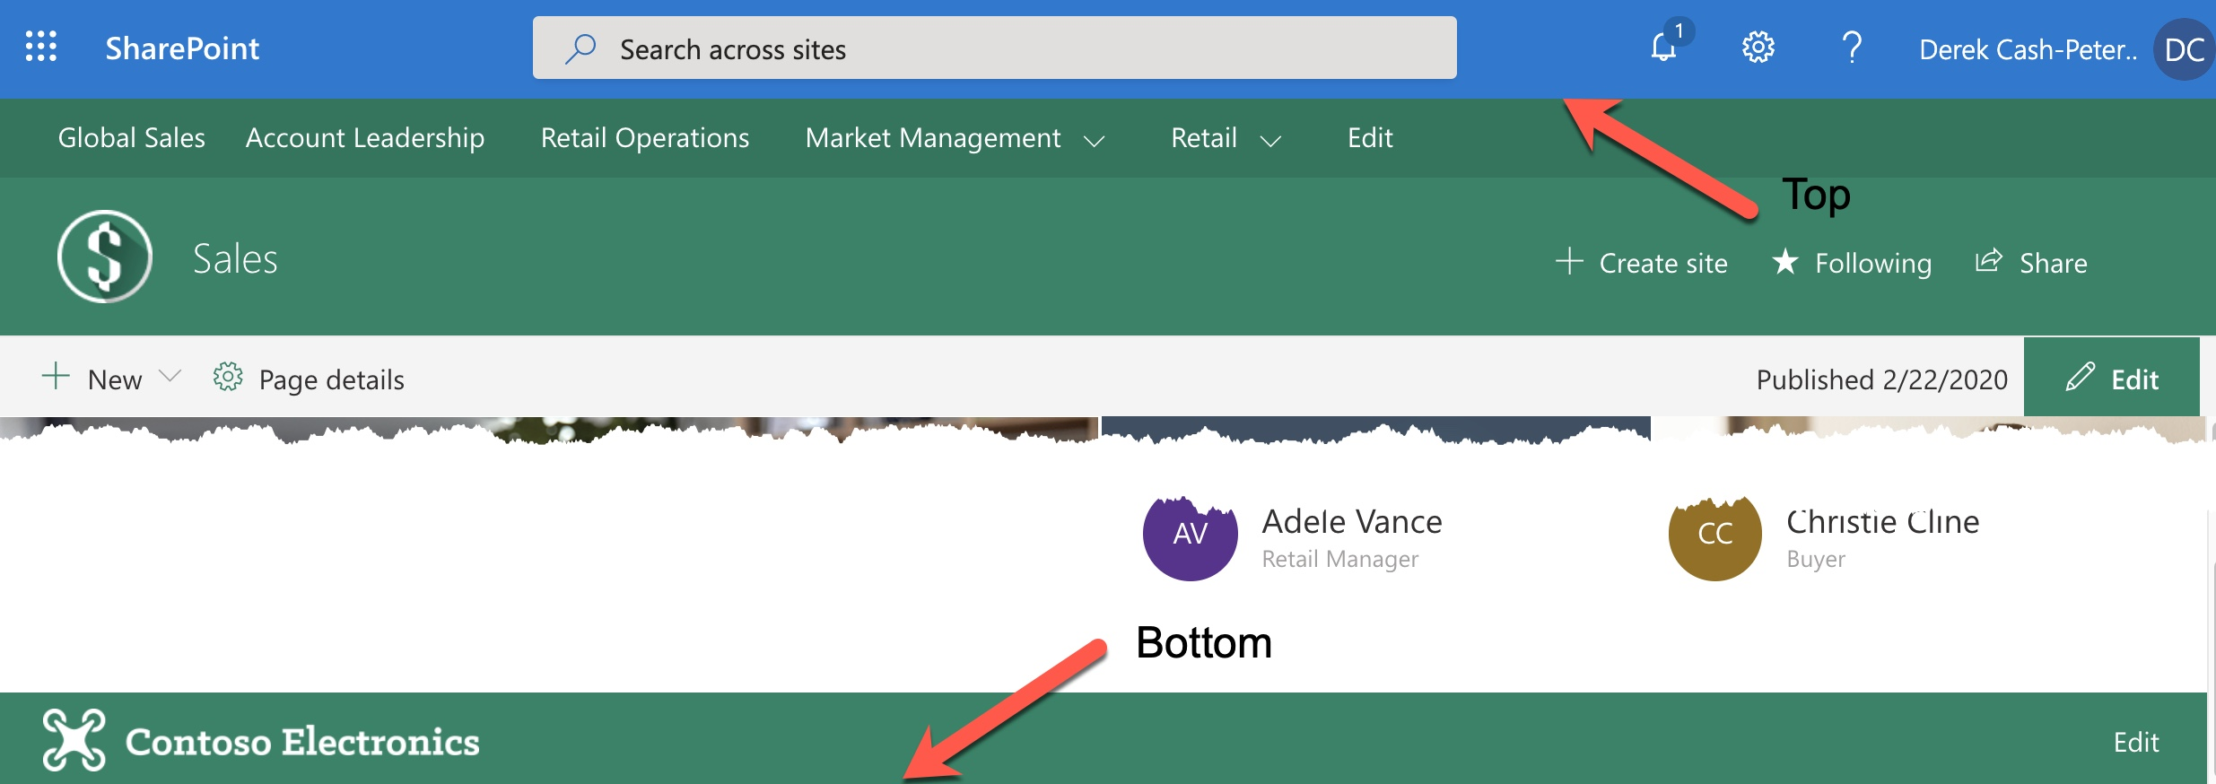
Placeholders

Slide 23
Data Source
JSON file in SharePoint Library
SharePoint List
Azure Function
Blob Storage
Endless possibilities

Slide 24
Application Customizers
SPFx Component that allows for customizations
Functionality that lets you determine which placeholder to embed your code in

Slide 25
Agenda
Why Build Your Own?
Anatomy of Global Navigation
PnP Dev Extensions Let’s Look at the Code!
Deployment
Q&A

Slide 26
What is PnP?

Slide 27
What is PnP?
Patterns & Practices

Slide 28
What is PnP?
Patterns & Practices
Community Driven

Slide 29
What is PnP?
Patterns & Practices
Community Driven
What’s Covered
Code Samples
Community Driven Best practices
Look Book
SPFX Generator
And much much more!

Slide 30
What is PnP?
Patterns & Practices
Community Driven
What’s Covered
Code Samples
Community Driven Best practices
Look Book
SPFX Generator
And much much more!
https://pnp.github.io

Slide 31
Time For Code!
01010100 01101001 01101101 01100101 00100000 01010100 01101111 00100000 01000011 01101111 01100100 01100101 00100001

Slide 32

Deployment
SPFx
Deploy to all site collections automatically
Deploy to specific site collections
Classic
JSLink
PowerShell to individual site collections

Slide 33

Recap

Slide 34
Recap
Why you would want to build your own?

Slide 35
Recap
Why you would want to build your own?
Anatomy of Global Navigation

Slide 36
Recap
Why you would want to build your own?
Anatomy of Global Navigation
PnP

Slide 37
Recap
Why you would want to build your own?
Anatomy of Global Navigation
PnP
Looked at Example

Slide 38
Recap
Why you would want to build your own?
Anatomy of Global Navigation
PnP
Looked at Example
Deployment

Slide 39
Resources
PnP Site
https://pnp.github.io/
SPFX Dev Extensions
https://github.com/SharePoint/sp-dev-fx-extensions/tree/master/samples/react-menu-footer-classic-modern
The Code
https://github.com/dcashpeterson/Public-Samples
Twitter
@spdcp

Slide 40


Slide 41
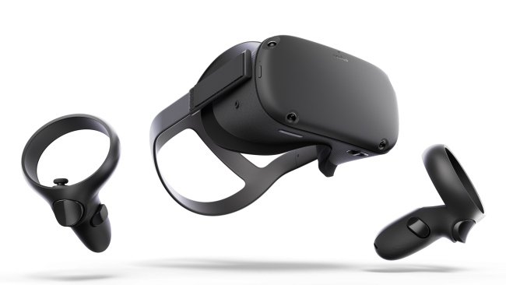
ARE YOU READY FOR A RAFFLE? We are giving away 3 Oculus Quest All In One!
Visit the Vendors Booth, Sessions and Watch the Videos
Submit Your Answers to Enter the Raffle
You need at least 5 correct answers then submit for a chance to win one of 3
(One in each Americas, APAC, EMEA)
https://bit.ly/m365raffle

Slide 42





CONSIDER DONATING TO THE FOLLOWING CHARITY RELIEF FUNDS: UNITED WAY OR INTERNATIONAL MEDICAL CORPS
THANK YOU FOR JOINING US! 10% OF FUNDS FROM SPONSORS GO TO SUPPORT COMMUNITY RELIEF
United Way: https://give.uwkc.org/M365VM
International Medical Corps: https://bit.ly/MedicalCorpsFund

Slide 43
THANK YOU FOR JOINING US!
DO YOU HAVE ANY QUESTIONS?
[Let’s Connect: @spdcp]
Brought to you by:
The Global Microsoft Community &
#M365VM
M365VirtualMarathon.com
M365Conf.com | #M365CONF

